Slide 1


GITHUB SCORE CALCULATOR
BY CHOLAVETI SAI NAVEEN

Slide 2
ABOUT GITHUB
At a high level, GitHub is a website and cloud-based service.
It helps developers to store and manage their code, as well as track and control changes to their code.
To understand exactly what GitHub is, you need to know two connected principles:
Version control
Git

Slide 3
What is version control ?
Version control helps developers track and manage changes to a software project’s code.
At this point word press is a pretty big project. If a core developer wants to work on the specific part of the word press code base , it is very difficult to moidify the total source code. In this case version control is used for developers to solve the problem using branching and merging techniques.

Slide 4
What is git ?
Git is a specific open-source version control system created by Linus Torvalds in 2005.
Specifically, Git is a distributed version control system, which means that the entire codebase and history is available on every developer’s computer, which allows for easy branching and merging.

Slide 5
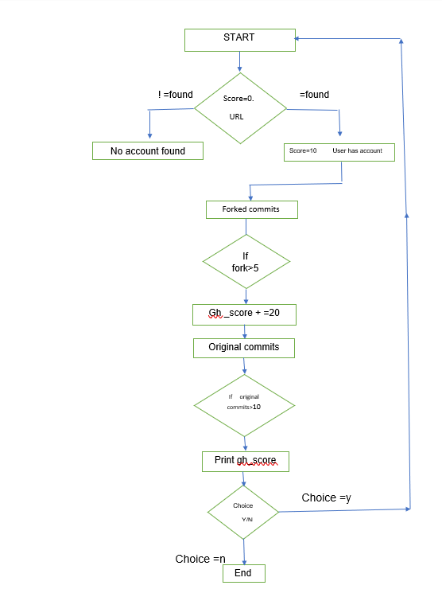
How the code will work ?

Slide 6
Libraries used in code…
Urllib2:
This can be used to fetch the URLS from the code.
Beautiful soup :
It is used for pulling data out of HTML and XML files.
In this code I used the version bs4 i.e beautiful soup 4.

Slide 7
screenshots

Slide 8
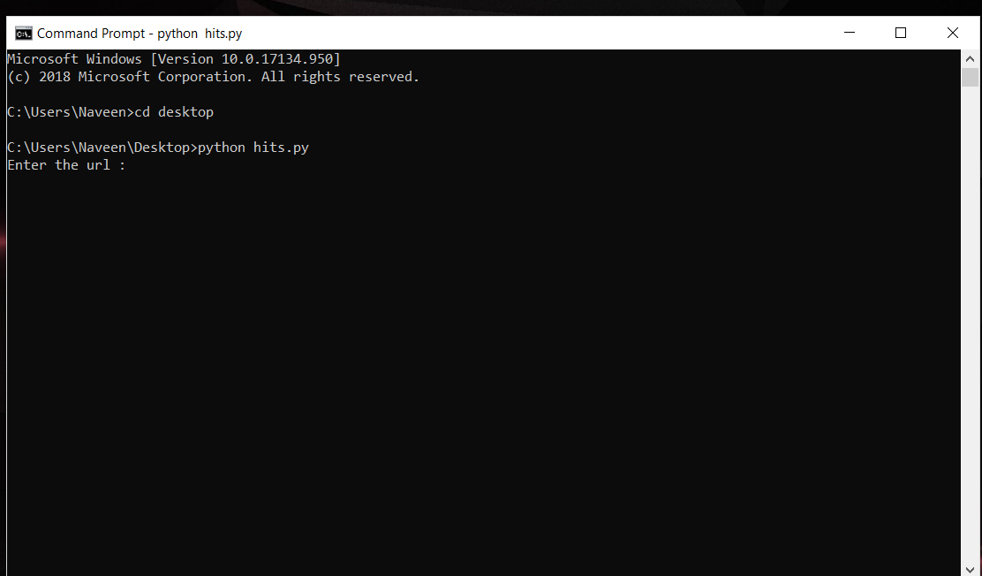
Fig 1:enter the url

Slide 9
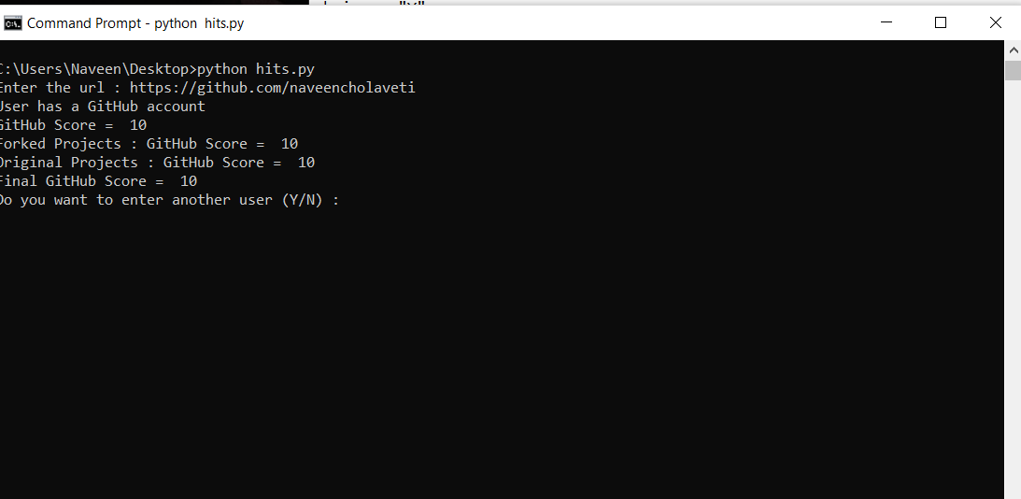
Fig 2:score is generated

Slide 10
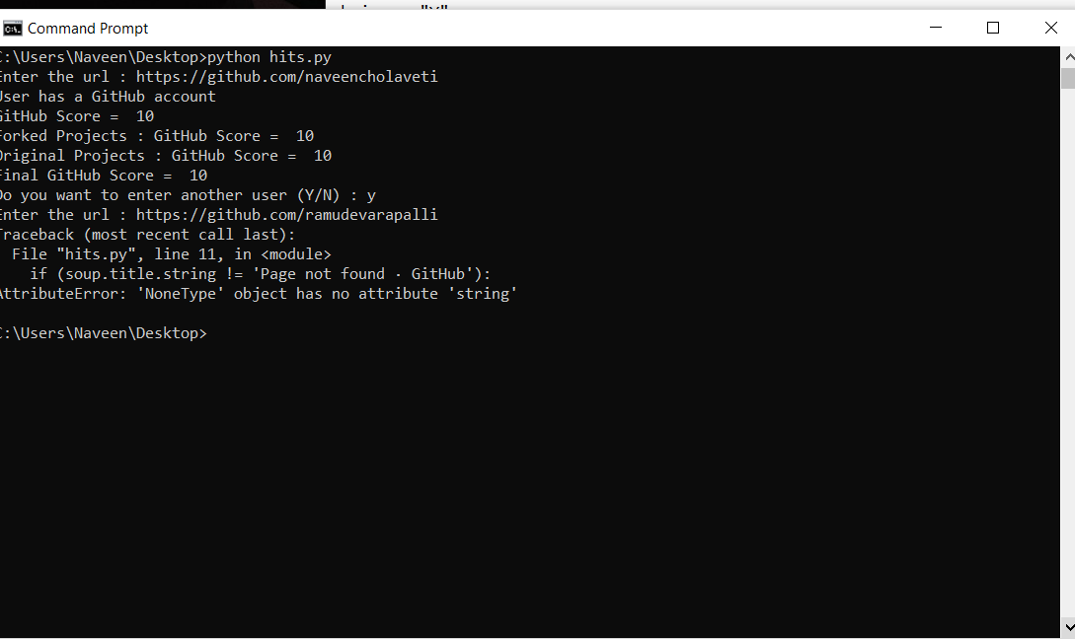
Fig 3: no account found

